Slide 1
Mohamammad Ikram b zulkifli sais aminuur azli b mat isa tunku muhamad ruhaizri b abdul Rahman sirajuddin abdul azizz kim3g

Slide 2
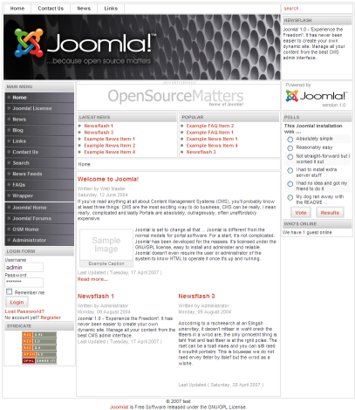
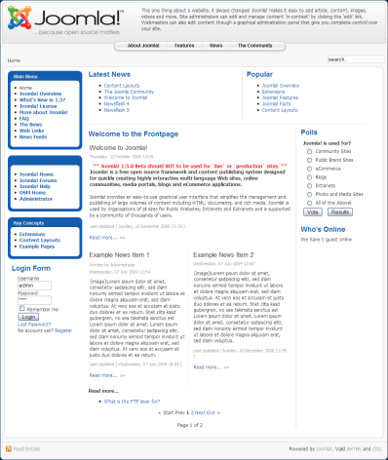
What is joomla! ?
Joomla! is one of the most powerful Open Source Content Management Systems on the planet. It is used all over the world for everything from simple websites to complex corporate applications. Joomla! is easy to install, simple to manage, and reliable.
Joomla is a free, open source content
management system
Organizes all forms of content
Easy to use and expandable

Slide 3
Why Use Joomla! ?
Simplicity
Intuitive Graphical Web User Interface (WebUI)
Flexibility
Highly configurable and tailorable
Robust
Extremely stable core infrastructure
Extensible
3rd Party Extension and Plug-In capabilities
Open Source Code
You can modify anything you like
Published API
Windows in the code allowing 3rd Party extension
Dynamic Content
MySQL database driven
Pro-Active Support
Joomla! Teams and Community members

Slide 4
How Can Joomla! Be Used?
Simple Websites
Community Portals
Magazines,Newspapers
Corporate Intranets
WebLog (Blog) Sites
E-Commerce Shops
B2B & B2C Frameworks
Customer Self-Service
Member/Directory Sites
NGO,Churches,Schools

Slide 5
Joomla! features
Joomla is so much more than just a powerful content management system. Here is a list of features "out of the box," but the true power of Joomla is in its extensibility.
User Management
Media Manager
Language Manager
Banner Management
Contact Management
Polls
Search
Web Link Management
Content Management
Syndication and Newsfeed Management
Menu Manager
Template Management
Integrated Help System
System Features
Web Services
Powerful Extensibility

Slide 6
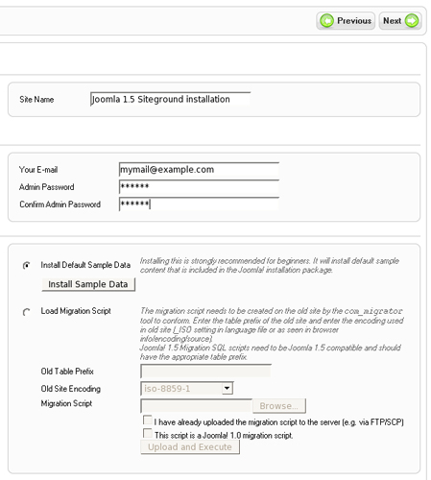
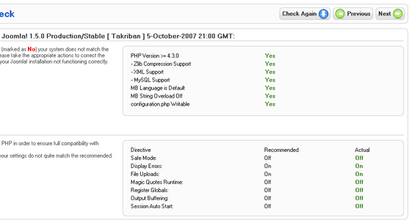
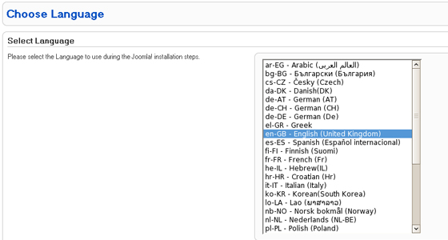
installation
Step 1.Create a MySQL database for your Joomla installation and add a new user to it. This can be done easily with cPanel by following the MySQL database tutorial. In case you are not using cPanel you can refer to the MySQL manual on creating databases and adding users to it.
Step 2. Create a folder called upload on your computer.
Step 3.Go to the Joomla download page. Download the .zip file with the latest version to the upload folder and extract it there.
Step 4.Upload all the content from upload to the directory on the server where Joomla 1.5 will be installed. SiteGround recommends using FTP for this purpose and the FTP tutorial will guide you through the necessary steps.
Step 5.Open the URL of the newly uploaded Joomla files. This will be either http://your_domain_name.com or a subdirectory such as http://your_domain_name.com/example.
Step 6.You will be redirected to the Joomla installation page:
Step 7.Joomla will perform a pre-installation check of the system environment. Failing to meet a requirement or recommendation may cause functional and security problems later.
Step 8.Once you make sure all requirements are met, click on the [Next] button from the top right menu.
Step 9.Next you will have to accept Joomla's license and click on [Next] to continue.
Step 10. The following page will ask about the MySQL details for the new Joomla 1.5 installation
Step 11. Next you will have to configure your File Transfer Protocol (FTP). Leave it to the default settings and just click [Next] from the top right menu.
Step 12. From the page that appears you will be able to complete the final Joomla 1.5 settings specifying your email and specifying the admin password. Click on [Next] to proceed.
Step 13. In the last page of the installation wizard you will receive a confirmation that Joomla has been successfully installed.
Before being able to access your new Joomla 1.5 you must delete the installation directory. For this purpose use FTP as described in Step 3.
Well done! Your Joomla website is now installed.

Slide 7
Advantages & disadvantages
Advantages:
PHP The Joomla framework was written completely in PHP scripting. As this is the most common scripting language on the planet your pages should display well and you should have limited compatibility issues. You also have preview modes to check the display. Simple Installation Joomla’s installation takes only a few minutes and is ready to use right out of the box. Anyone who can download from the Internet can install and begin using Joomla although its installation is more difficult than WP. Sophisticated Hierarchies In the more recent versions of Joomla they have created a more complex navigation pattern that can easily support more than two-level hierarchies. This provides for more in-depth websites with hundreds of pages, as opposed to WordPress, which was not designed with hierarchies in mind.
Plugins and Components Joomla has significantly more plugins and components than Drupal (although less modules and templates). WordPress by far has the most but there is a lot of functionalities built right into Joomla that means it requires less plugins than WordPress.
Support Joomla.org has a huge selection of development tools and tutorials available for its users. It also has large user-led communities where you can get advice, tips and tricks. There are over 200,000 in its online community for you to connect with, which means you can find an answer to any problem quickly.
Disadvantages
Beginner to Intermediate Usability Joomla was designed mainly for simple websites and blogs, and for people with only some knowledge of building. This means that it does not have much advanced functionalities for those looking to truly customize complex sites.
Security Every site in Joomla will use its own login details which makes the work easier but the site less secure.
Limited Customization Joomla has 80 modules and a reasonable amount of templates but will still feel too cookie-cutter for more advanced users, although less so than WordPress.
Resources The system and sites can use a large amount of server resources comparable to other CMS solutions, which means you could only run a couple of sites successfully. Even with only a couple of sites running you may experience slow loading times.
Costs Check out the functionality you need before choosing your CMS if you have a very limited or constrained budget.
SEO Un-Friendly Out-of-the-box Joomla is not very SEO friendly, although the SEO will be greatly enhanced with the SEF plugin installed.
Odd Level of Complexity Many users fall into the beginner or advanced levels of web design and therefore prefer the simplicity of WordPress or the advanced toolset of Drupal. Many users therefore find Joomla too difficult or too basic.
User Quantity
Compatibility There are compatibility problems when installing several modules, extensions and plugins simultaneously. This can be incredibly frustrating if you are near the end of the site and just realized that an add-on you scoped out earlier isn’t compatible with the module you used to build.

Slide 8
Modules / components / plugin
Modules
Modules are more lightweight and flexible extensions used for page rendering. These modules are mostly known as the “boxes” that are arranged around a component, for example: the login module. The footer is a module. Modules are assigned per menu item. So, you can decide to show or hide the logon module depending on which menu item the user is viewing. Sometimes modules are linked to components such as the “latest news” module which links to the com_content and displays links to the newest content items. However, modules do not need to be linked to components, as a matter of fact they don't even need to be linked to anything and can be just static HTML or text.
Examples: Banners (mod_banners), Menus (mod_menu), Who's Online (mod_whosonline)
Components
Components are the largest and most complex extensions of them all; they can be seen as mini-applications. Most components have two parts: a site part and an administrator part. Every time a Joomla page loads, one component is called to render the main page body. For example, Content (com_content) is the component which handles the display of content; users can view at the frontend of your site and, as an administrator, you can edit the content. Components are the major portion of your page because a component is driven by a menu item and every menu item runs a component.
Examples: Content (com_content), Banners (com_banners), Contact (com_contact), News Feeds (com_newsfeeds) and Web Links (com_weblinks)
Plugins
Plugins are more advanced extensions and are in essence event handlers. In the execution of any part of Joomla, be it the core, a module or a component, an event can be triggered. When an event is triggered, plugins that are registered with the application to handle that event execute. For example, a plugin could be used to intercept user-submitted articles and filter out bad words. Plugins were known in Joomla! 1.0 as mambots.
Examples: content.searchbot, tinymce

Slide 9
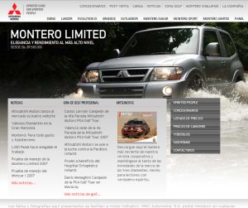
Who's Using Joomla! ?
Mitsubishi Venezuela The history of Mitsubishi Motors Corporation dates back to 1870, the year that the Tsukumo Shokai shipping company was founded. Mitsubishi Heavy-Industries, which can trace its origins to Tsukumo Shokai, launched the "Mitsubishi Model-A" project in 1917, one of the pioneers of Japanese mass-production passenger cars.

Slide 10
Thank you

